Slide 1
Vocabulary
Red Hot Root Words
11-30-09

Slide 2
Prefixes
Root Words Meaning Words You Already Know
ad to, toward advance
re back, again repeat
se apart, away separate
Notes:
Input:
Present the root words” Explain their meanings.
CFU:
Ask students to tell you another word with fore
Repeat with other root words.

Slide 3
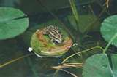
Adapt (verb)
to change to be suitable or fit
If this type of frog can adapt to the pollution in the water, it may survive.
Notes:
Input:
Present the word
State the part of speech
Read the definition and sentence
Point out the suffix on the word
Tell students to make sure they are familiar with how the word is used in the sentence
CFU:
Ask a student to give a paraphrase, example, or another sentence
Ask a different student to provide an example or another sentence using the word
Model:
If students are not able to do the CFU, provide a paraphrase and an example
Do this for any word that the students cannot paraphrase or give an example for.

Slide 4
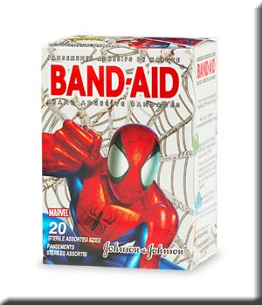
Adhere (verb)
To stick to something; conform to; obey
To make a bandage adhere, make sure your skin is dry when you put it on.
Notes:
Input:
For each of the following slides (with vocabulary words) have each student in turn:
Present the word
State the part of speech
Read the definition and sentence
Point out the suffix on the word
CFU:
Ask one of the other students to give a paraphrase of the definition, and another to provide an example or another sentence using the word.
Provide positive verbal feedback for each.
Restate the example or paraphrase if unclear how it relates (informal error correction)

Slide 5
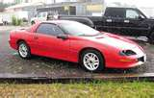
Adjacent (adjective)
Close to, bordering on
The black car was parked adjacent to the red truck.
Notes:
Input:
Have students to identify the part of speech, read the definition and the sentence.
Clarify/restate any information that is unclear or inaccurate.
Point out the suffix on the word
CFU:
Ask a student to give a paraphrase of the definition
Ask a different student to provide an example or another sentence using the word

Slide 6
Recurrent (adjective)
Happening again and again, returning periodically
A recurrent theme of his books is that bravery brings great rewards.
Notes:
Input:
Have students to identify the part of speech, read the definition and the sentence.
Clarify/restate any information that is unclear or inaccurate.
Point out the suffix on the word
CFU:
Ask a student to give a paraphrase of the definition
Ask a different student to provide an example or another sentence using the word

Slide 7
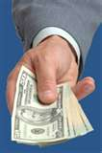
Reimburse (verb)
Pay back, refund
I’ll pay for your ticket to the theater if you reimburse me later.

Slide 8
Reiterate (verb)
Repeat many times
Let me reiterate what I said so you won’t forget.
Notes:
Input:
Have students to identify the part of speech, read the definition and the sentence.
Clarify/restate any information that is unclear or inaccurate.
Point out the suffix on the word
CFU:
Ask a student to give a paraphrase of the definition
Ask a different student to provide an example or another sentence using the word

Slide 9
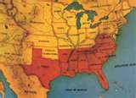
Secession (noun)
The act of withdrawing from an alliance or association
The northern states threatened secession from the union if they didn’t get more power in the government.
Notes:
Input:
Have students to identify the part of speech, read the definition and the sentence.
Clarify/restate any information that is unclear or inaccurate.
Point out the suffix on the word
CFU:
Ask a student to give a paraphrase of the definition
Ask a different student to provide an example or another sentence using the word

Slide 10
Seclude (verb)
To withdraw or set apart from social contact
The teacher secluded the talkative child by putting him in the corner by himself.
Notes:
Input:
Have students to identify the part of speech, read the definition and the sentence.
Clarify/restate any information that is unclear or inaccurate.
Point out the suffix on the word
CFU:
Ask a student to give a paraphrase of the definition
Ask a different student to provide an example or another sentence using the word

Slide 11
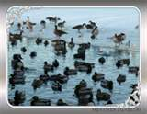
Segregate (verb)
To separate from the rest of the group
Segregate the geese from the ducks and put the ducks in a pen.
Notes:
Input:
Have students to identify the part of speech, read the definition and the sentence.
Clarify/restate any information that is unclear or inaccurate.
Point out the suffix on the word
CFU:
Ask a student to give a paraphrase of the definition
Ask a different student to provide an example or another sentence using the word

Slide 12
Sequester (verb)
To separate or withdraw; to choose solitude or retirement
After being around people all day, she just wanted to sequester herself in her bedroom.
Notes:
Input:
Have students to identify the part of speech, read the definition and the sentence.
Clarify/restate any information that is unclear or inaccurate.
Point out the suffix on the word
CFU:
Ask a student to give a paraphrase of the definition
Ask a different student to provide an example or another sentence using the word

Slide 13
Practice using the new words!
Notes:
The independent practice that goes with this lesson will be introduced with this slide. As it is modified, I will not present it on the PPT or SB as that may cause confusion for the students who have the unmodified version. However, the following is how I will review the worksheet with the whole class:
Input:
Read the directions for the first section.
CFU: Ask if there are any questions
Guided Practice/Modeling:
Read the two words listed for the first question.Ask if the two words have the same meaning or different meanings. Model looking up the meaning for construe – note that assume the meaning is part of the definition. Have a student say that the words have the same meaning. Have the students circle same. Tell them they will do the same for 2-8.
CFU: ask if there are questions
Input: read the directions for the second section
Guided Practice: read the word for #9. Explain that they are to determine the meaning of port and then add the meaning of er. Give the example of teach + er…someone who teaches. Say to do the same thing for port, but that someone who ports doesn’t make sense, so they will need to look at the MEANING for port…to carry from one palace to another. A porter is someone who carries things from one place to another. Have students write in answer. Tell them to do the remaining two questions the same way.
CFU ask for questions.
Input: read the directions for the third question.
G.P. Do the first one together. Have three different students name one thing that is portable. Have students write in the answers.
CFU ask for questions
IP: have students complete the worksheet independently. CFU: circulate. Monitor for correct answers. If time allows when students are finished, go over the answers as class.
Closure: Remind students to review the words during the week. Remind them that if they learn the root words they will add more than just those ten words to their vocabulary. Have students turn in worksheets to appropriate areas.

